Slide 1
DATA STRUCTURES PROJECT
TEAM 5
ENEA KLLOMOLLARI
MARCELLO RUSCIANO
KAMALJOT SAINI
CARLO EMPAYNADO
ZACHARY PASCUAL

Slide 2

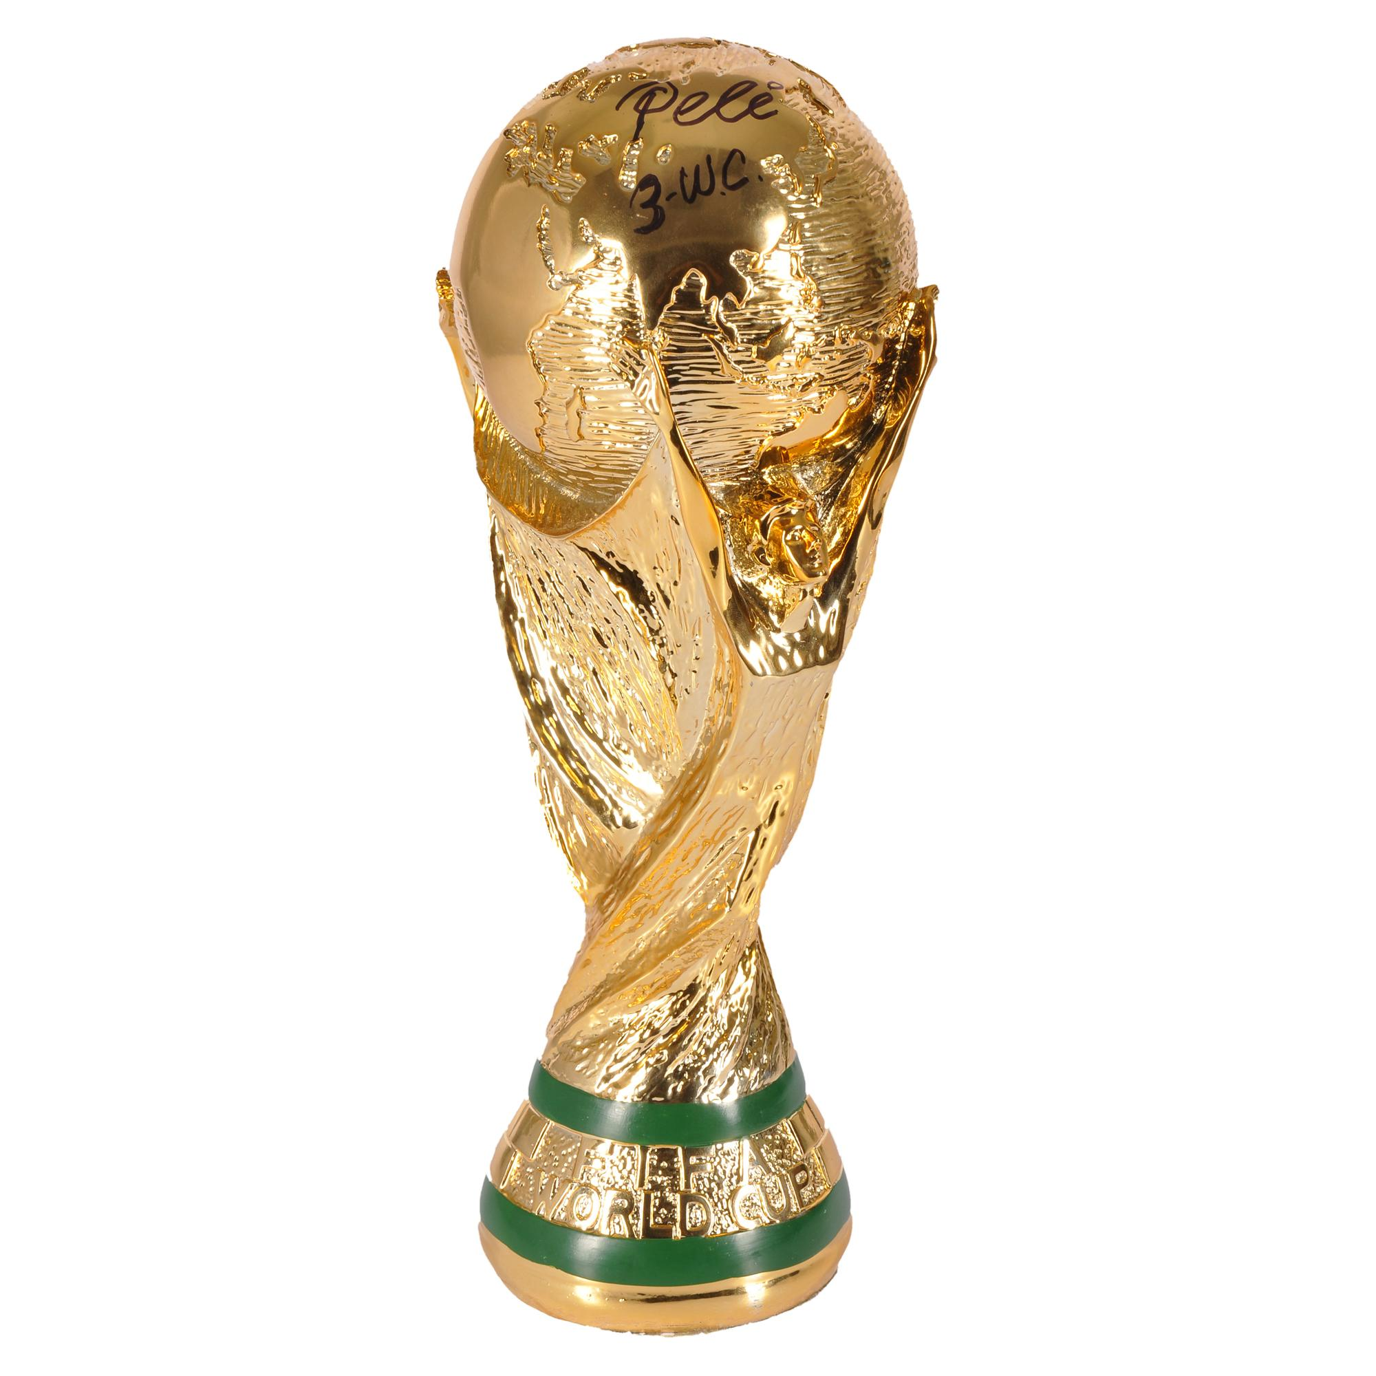
SOCCER COMPETITIONS
EURO CUP
WORLD CUP
GENERAL INFORMATION
Year Held: 2016
Winning Country: Portugal
Host Country: France
Best Player: Antoine Griezmann
Average goals per game: 2.12
Number of games: 51
Average attendance: 47 594
Total attendance: 2 427 303

Slide 3
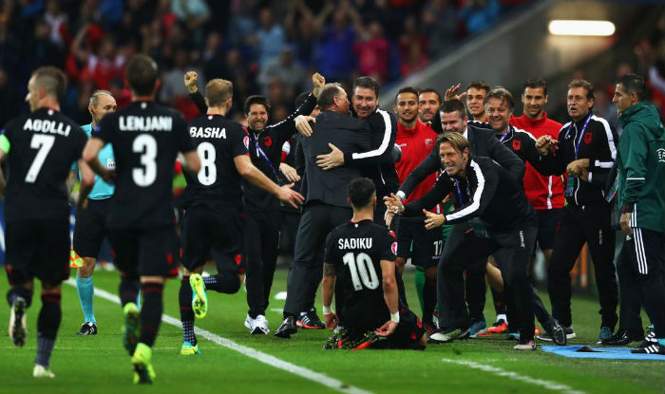
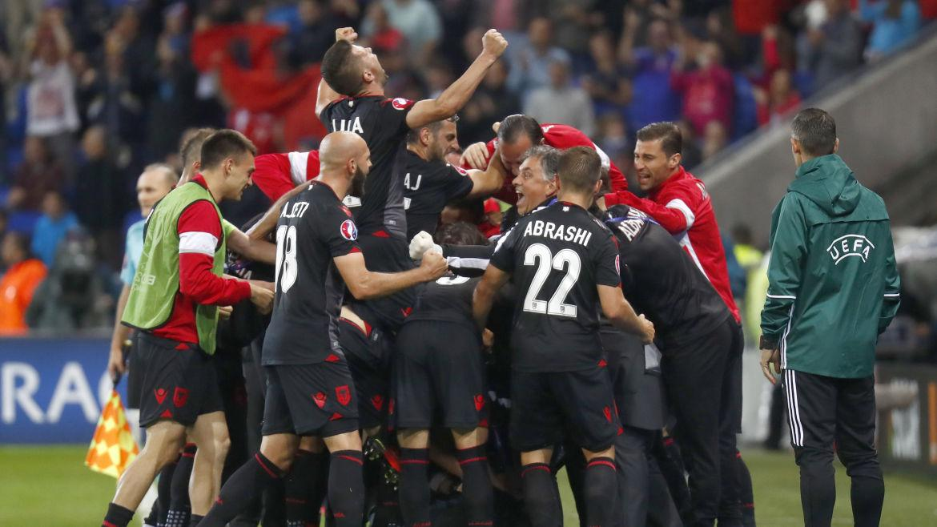
Teams Participated
Year Held: 2016
France 13. Albania
England 14. Romania
Czech Republic 15. Germany
Iceland 16. Poland
Austria 17. Russia
Northern Ireland 18. Slovakia
Portugal 19. Croatia
Spain 20. Turkey
Switzerland 21. Hungary
Belgium 22. Ukraine
Italy 23. Republic of Ireland
Wales 24. Sweden

Slide 4
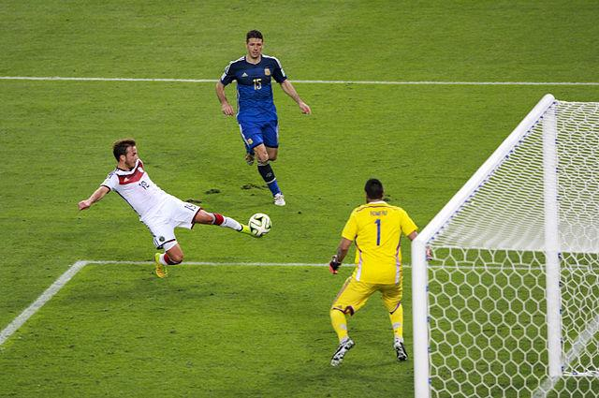
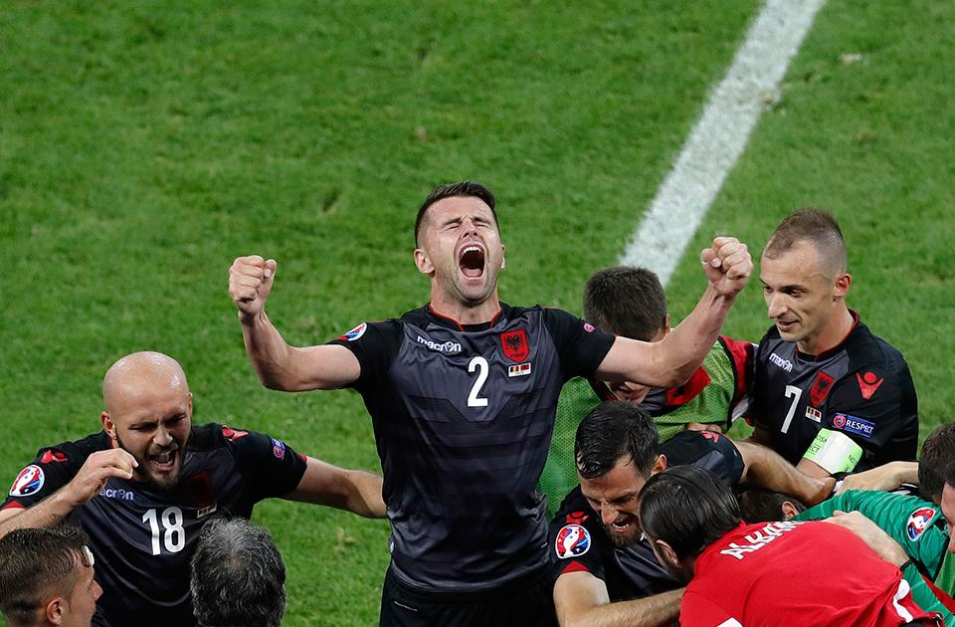
FINAL MATCH
Year Held: 2016
Finalist 1: France
Finalist 2: Portugal
Final Result: 0 - 1
Host City: Paris
Stadium Played: Parc des Princes

Slide 5
Program Features
Add
Remove
Search BST
By Year
List in hash table sequence
List Sorted by key
Efficiency
Undo Delete
Save Changes
Exit with changes saved

Slide 6
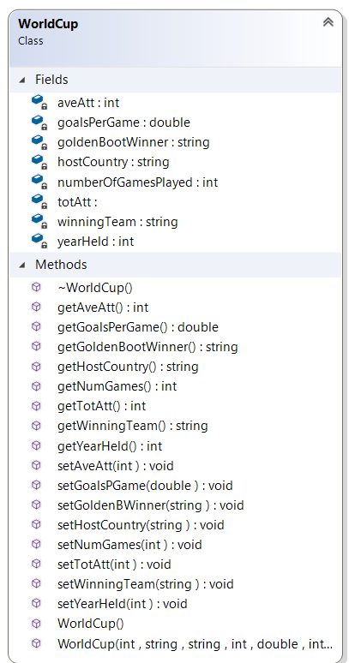

Slide 7
DATA DIAGRAM
headNode
worldCupHashTable
yearHeldTree
yearheldBST
yearHeldHashTable
0
1
2
3

Slide 8
DATA DIAGRAM
headNode
worldCupHashTable
yearHeldTree
yearheldBST
yearHeldHashTable
0
1
2
3
year
gpg
winner
bPlayer
hostC
aveAtt
totAtt
numGames
WorldCup A
year
gpg
winner
bPlayer
hostC
aveAtt
totAtt
numGames
WorldCup B
WorldCup C
year
gpg
winner
bPlayer
hostC
aveAtt
totAtt
numGames
year
gpg
winner
bPlayer
hostC
aveAtt
totAtt
numGames
WorldCup D

Slide 9
DATA DIAGRAM
headNode
DATA DIAGRAM
worldCupHashTable
yearHeldTree
yearheldBST
yearHeldHashTable
0
1
2
3
year
gpg
winner
bPlayer
hostC
aveAtt
totAtt
numGames
WorldCup A
year
gpg
winner
bPlayer
hostC
aveAtt
totAtt
numGames
WorldCup B
WorldCup C
year
gpg
winner
bPlayer
hostC
aveAtt
totAtt
numGames
year
gpg
winner
bPlayer
hostC
aveAtt
totAtt
numGames
WorldCup D

Slide 10
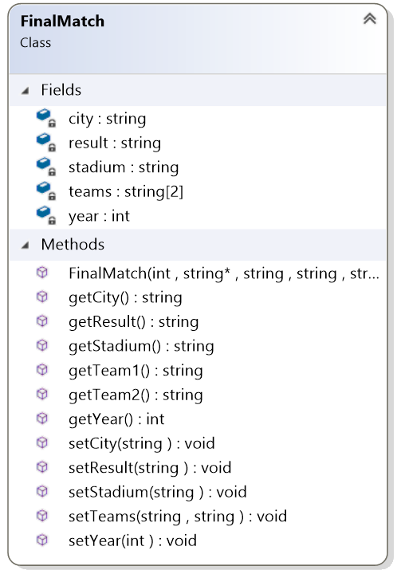

Slide 11
DATA DIAGRAM
headNode
finalMatchHashTable
finalMatchBST
finalMatchHashTable
finalMatchBST
0
1
2
3

Slide 12
DATA DIAGRAM
headNode
finalMatchHashTable
finalMatchBST
finalMatchHashTable
finalMatchBST
0
1
2
3
FinalMatch A
year
stadium
city
result
teams
FinalMatch B
year
stadium
city
result
teams
FinalMatch C
year
stadium
city
result
teams
FinalMatch D
year
stadium
city
result
teams

Slide 13
DATA DIAGRAM
headNode
finalMatchHashTable
finalMatchBST
finalMatchHashTable
finalMatchBST
0
1
2
3
FinalMatch A
year
stadium
city
result
teams
FinalMatch B
year
stadium
city
result
teams
FinalMatch C
year
stadium
city
result
teams
FinalMatch D
year
stadium
city
result
teams

Slide 14
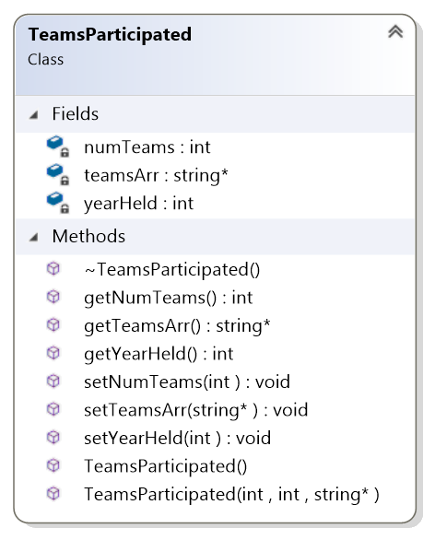

Slide 15
DATA DIAGRAM
headNode
teamsHashTable
teamsBST
teamsBST
teamsHashTable
0
1
2
3

Slide 16
DATA DIAGRAM
headNode
teamsHashTable
teamsBST
teamsBST
teamsHashTable
0
1
2
3
Dynamically allocated(based on the size of data)
year
numTeams
teamsArr*
TeamsParticipated A
year
numTeams
teamsArr*
Teams Participated B
year
numTeams
teamsArr*
Teams Participated C
year
numTeams
teamsArr*
Teams Participated D

Slide 17
DATA DIAGRAM
headNode
DATA DIAGRAM
teamsHashTable
teamsBST
teamsBST
teamsHashTable
0
1
2
3
year
numTeams
teamsArr*
Dynamically allocated
Teams Participated A
year
numTeams
teamsArr*
Dynamically allocated
Teams Participated B
year
numTeams
teamsArr*
Dynamically allocated
Teams Participated C
year
numTeams
teamsArr*
Dynamically allocated
Teams Participated D

Slide 18
Key
Hashing function
Hashes
0
1930
1
// TABLE_SIZE is a prime number
int HashTable<K, T>::hash(const K key)const
{
const int prime_1 = 5;
const int prime_2 = 7;
return (prime_1 * key + prime_2) %TABLE_SIZE;
}
1972
...
2012
22
23
2006
...
2008
39
2006
40
1984
41
Notes:
5,7

Slide 19
Collision Resolution: Chaining
bool HashTable<K, T>::put(K searchKey, T newItem)
{
//Check and see if re_hash is needed
if (loadFactor() >= 85.00)
re_hash();
// Create entry to add to hash table
HashEntry<K, T>* entryToAddPtr = new HashEntry<K, T>(searchKey, newItem);
// Compute the hashed index into the array
int itemHashIndex = hash(searchKey);
// Add the entry to the chain at itemHashIndex
if (hashTable[itemHashIndex] == nullptr)
hashTable[itemHashIndex] = entryToAddPtr;
else
{
numCollisions++;
//Insert it at the beggining of the chain
entryToAddPtr->setNext(hashTable[itemHashIndex]);
hashTable[itemHashIndex] = entryToAddPtr;
}
itemCount++;
return true;
}
Notes:
5,7

